Slide 1



Slide 2
What is Airflow?
Apache Airflow is used as a workflow management platform.
It is run by the Apache Software Foundation and was originally created by Airbnb. It is written in Python.
It can schedule and monitor different tasks.
Example: Daily data mining of the weather
A -> B -> C -> D:
A: get the current weather for Kiel as JSON
B: load it into a Data Frame
C: present it in a graph
D: send the graph to your subscribers by e-mail

Slide 3
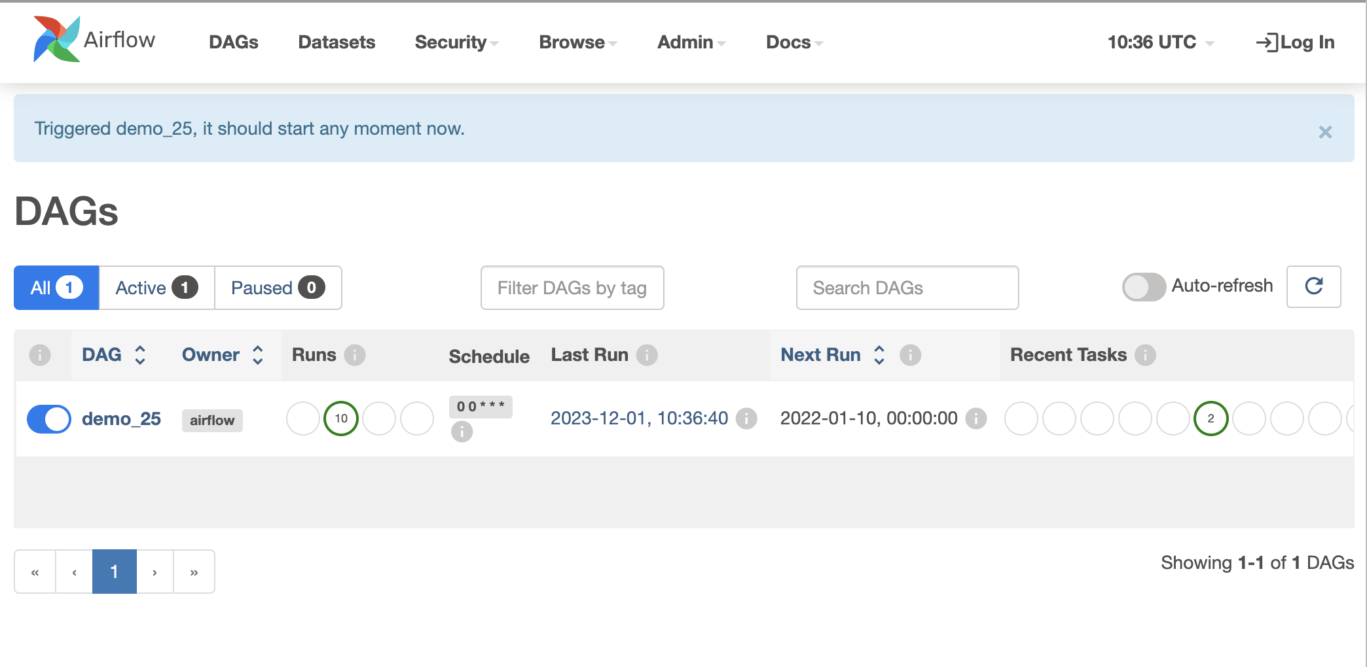
The Airflow UI

Slide 4
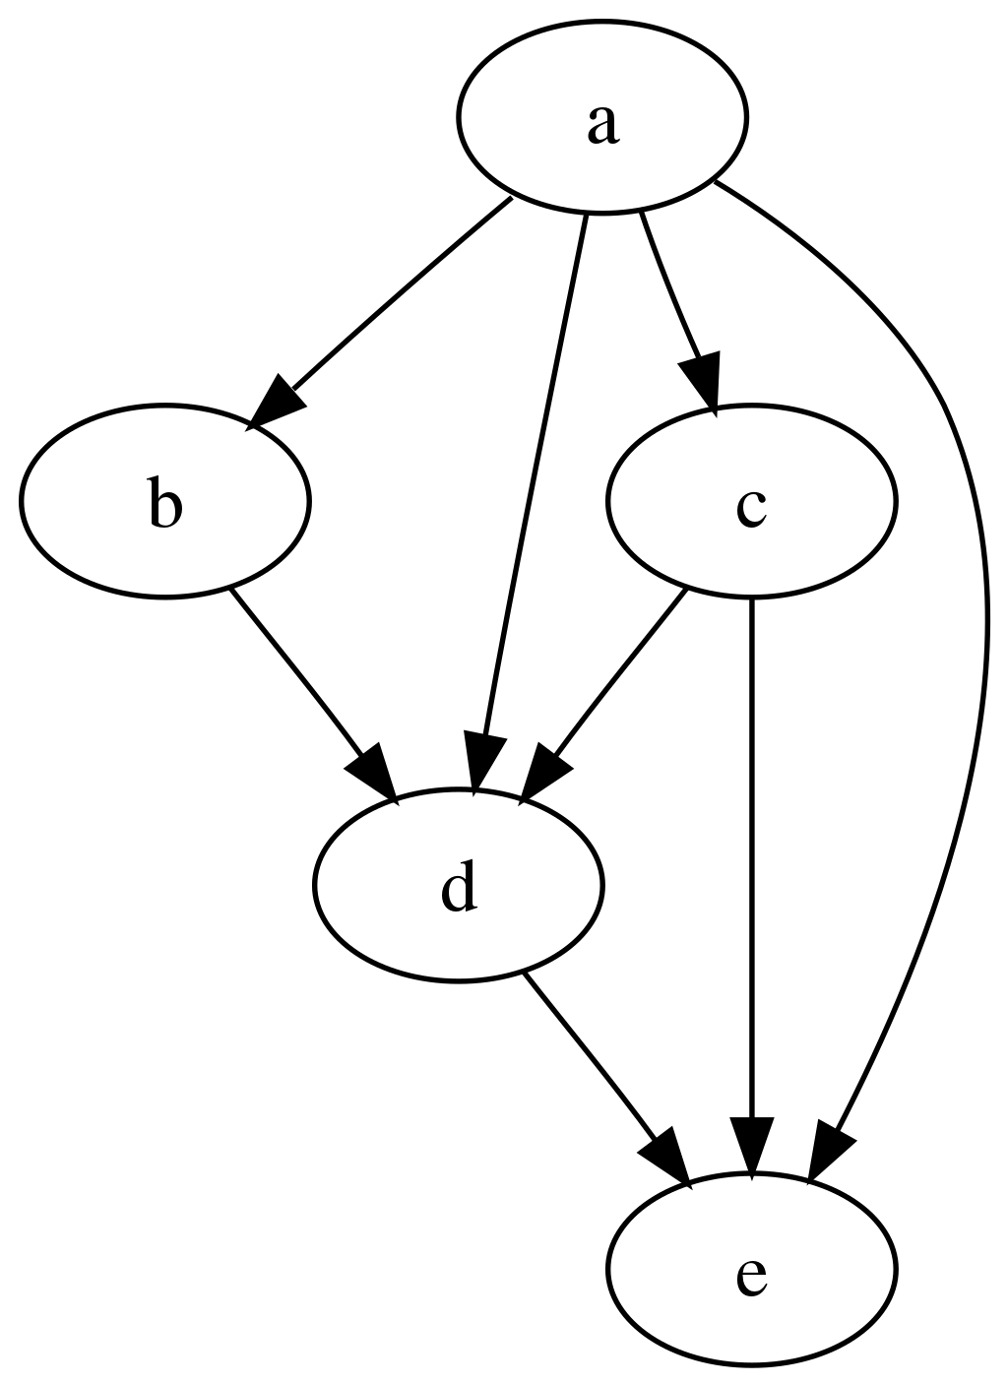
DAG
DAG stands for Directed Acyclic Graph.
Directed -> One Direction only, e.g. A -> B and
not A <-> B
Acyclic -> no repeated loop is formed!

Slide 5
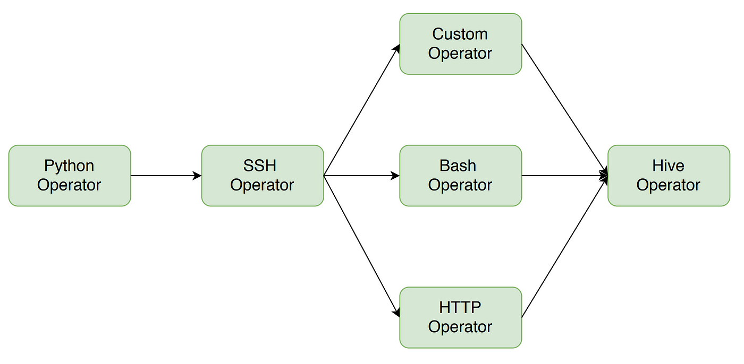
Example

Slide 6
The Code Structure
There are two different syntaxes for using Airflow
Original
Uses Operators, Tasks and Xcom (data connection between tasks) more specifically
Need to specify Operator directly
Give the task_id and python_callable
Xcom is more difficult
TaskFlow
Your code is mainly in Python
Automatic recognition of tasks and easier data handling between tasks
Open: Airflow.ipynb

Slide 7
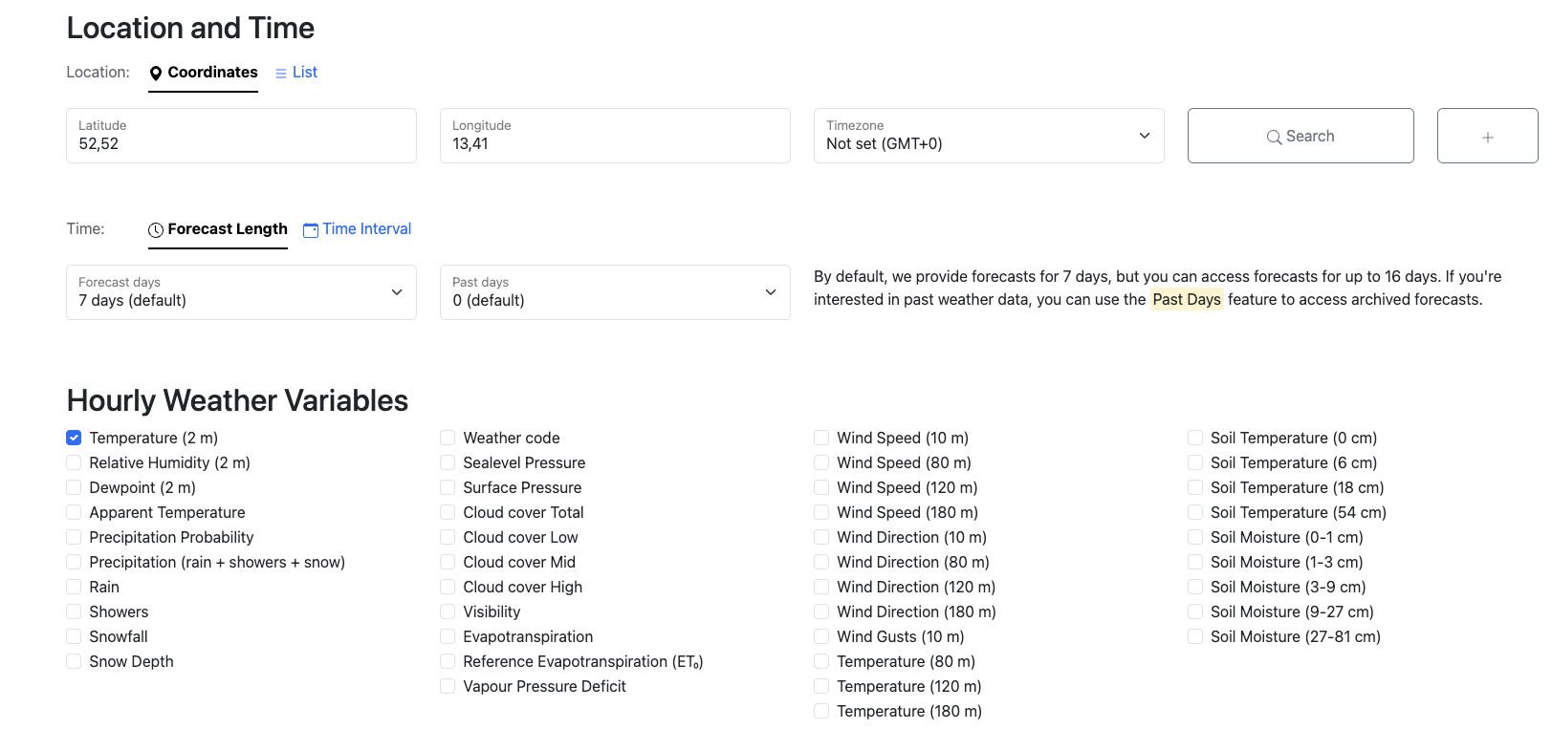
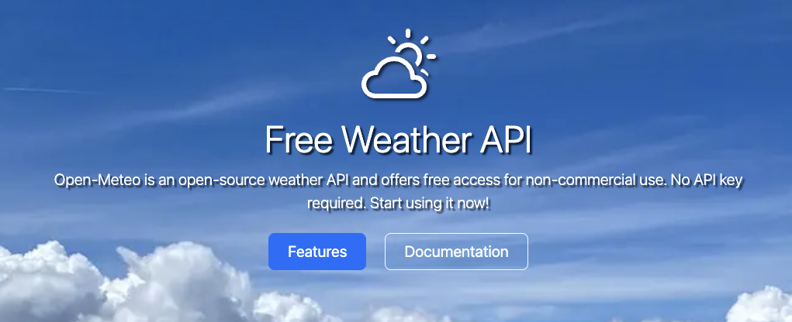
Hands-on Example: Weather by Open Meteo
Open Meteo is an easy to use weather API with no need for a key
Open Weather. Ipynb and learn how it works

Slide 8
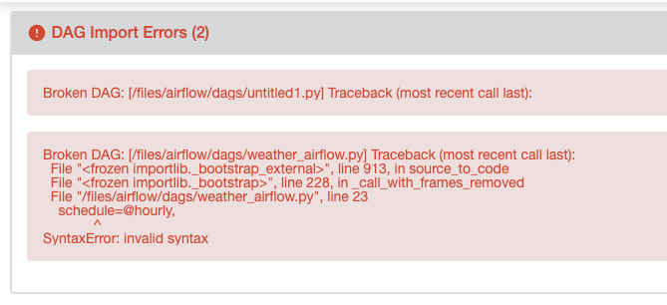
Try to build your own Weather DAG
I would recommend TaskFlow
In case something is wrong, a popup on the Airflow Ui will show up:

Slide 9
References
Airflow Guide
Cool Guide by astronomer.io for Airflow

